Slide 1
RECITATION 10: bandits
15.774/780 (Fall 2021)

Slide 2
Announcements
Last recitation of the semester ☹
Remaining recitations are project office hours
Notes:
Write formulas on the board before class

Slide 3
Agenda
Multi-Armed Bandits (MAB)
ε-Greedy (+decaying)
UCB
Thompson Sampling
Notes:
Write formulas on the board before class

Slide 4
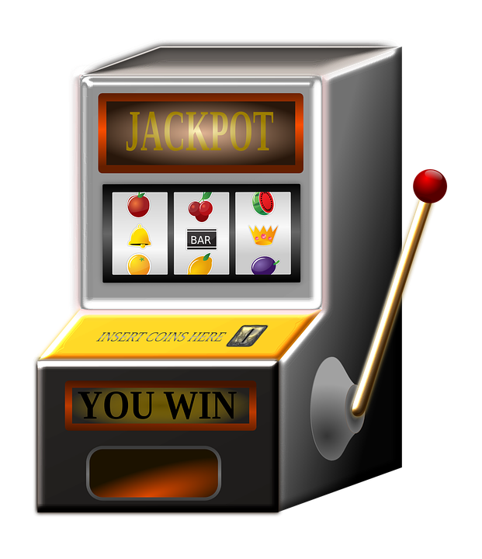
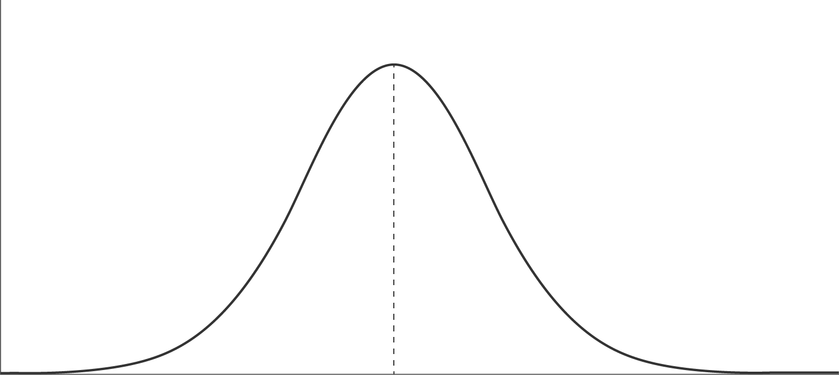
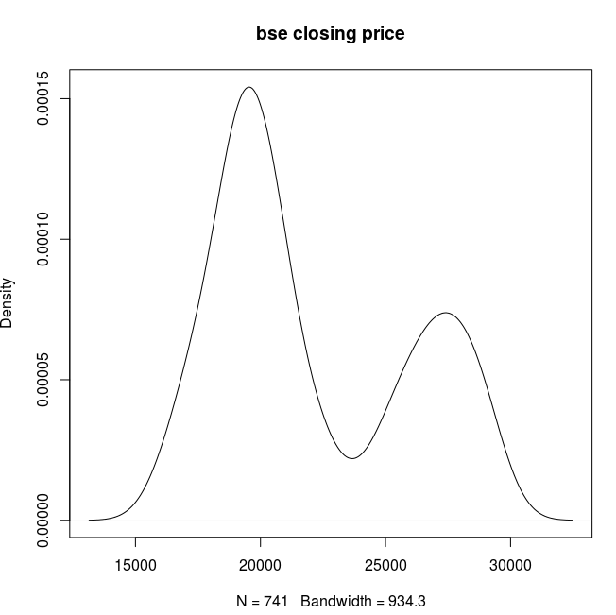
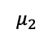


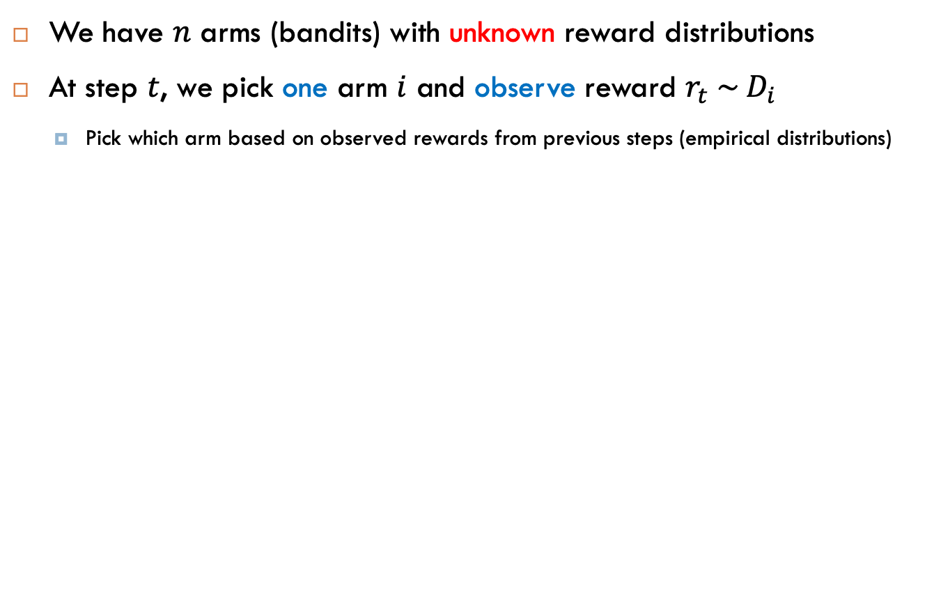



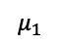



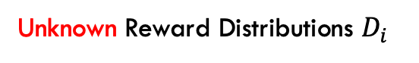
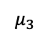

MAB Setting
We have $n$ arms (bandits) with unknown reward distributions
At step $t$, we pick one arm $i$ and observe reward $r_{t} \sim { D}_{i}$
Pick which arm based on observed rewards from previous steps (empirical distributions)
$$r_{9}$$
$$r_{2}$$
$$r_{6}$$
Arm 1
$$μ_{1}$$
$$r_{4}$$
$$r_{7}$$
Arm 2
$$μ_{2}$$
$$r_{5}$$
$$r_{8}$$
$$r_{1}$$
$$r_{3}$$
Arm 3
$$μ_{3}$$
Unknown Reward Distributions $D_{i}$
Observed Rewards
Notes:
Write formulas on the board before class

Slide 5
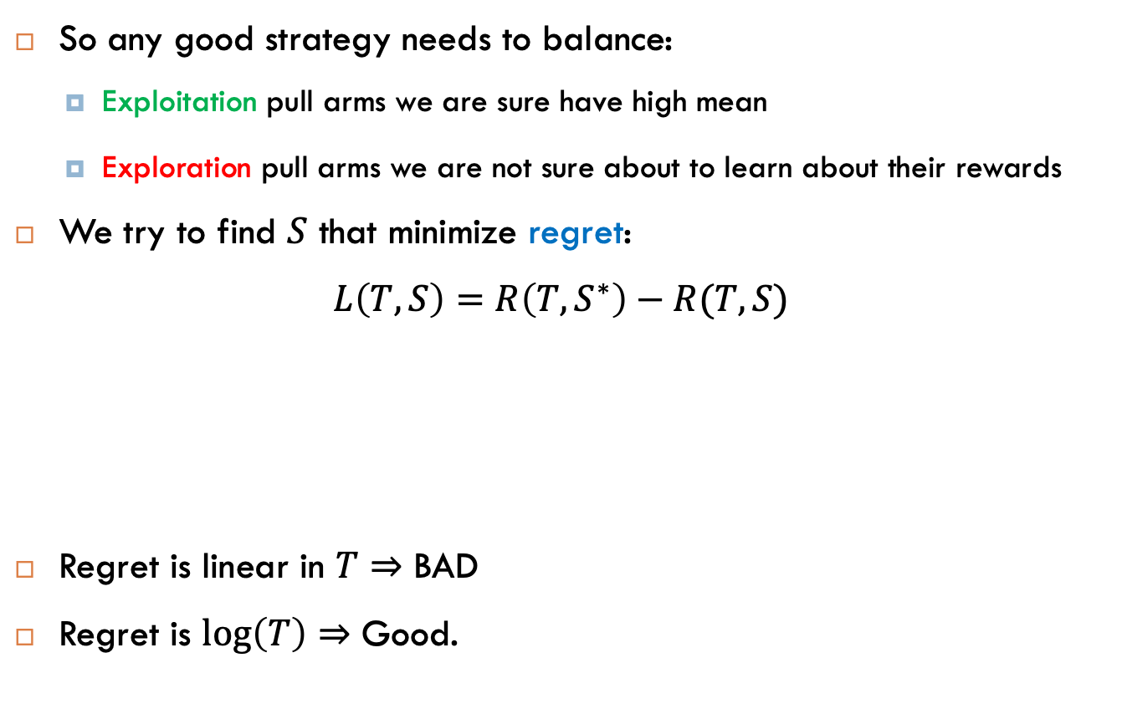
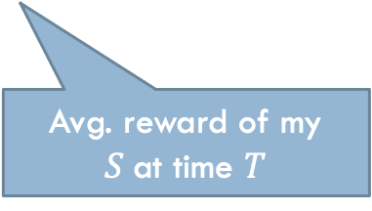
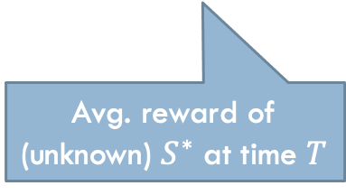
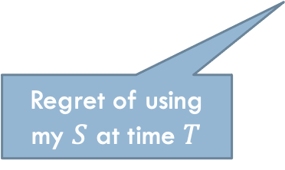
MAB Setting
So any good strategy needs to balance:
Exploitation pull arms we are sure have high mean
Exploration pull arms we are not sure about to learn about their rewards
We try to find $S$ that minimize regret:
$$L\left(T,S\right)=R\left(T,S^{∗}\right)−R(T,S)$$
Regret is linear in $T$ $⇒$ BAD
Regret is $\log\left(T\right)⇒$ Good.
Regret of using my $S$ at time $T$
Avg. reward of (unknown) $S^{∗}$ at time $T$
Avg. reward of my $S$at time $T$
Notes:
Write formulas on the board before class

Slide 6
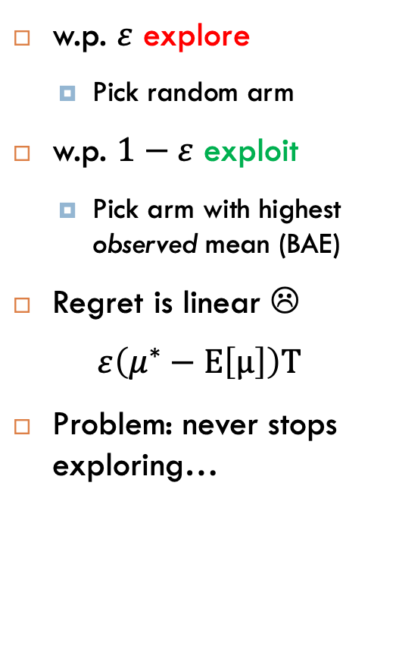
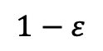
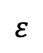
ε-Greedy
w.p. $ε$ explore
Pick random arm
w.p. $1−ε$ exploit
Pick arm with highest observed mean (BAE)
Regret is linear ☹
$$ε\left(μ^{∗}−Ε\left[μ\right]\right)Τ$$
Problem: never stops exploring…
Arm 1
Explore
1/n
Test arms
1/n
Arm 2
$$ε$$
Start of round t
…
1/n
…
Arm n
$$1−ε$$
Exploit
Best arm in expectation (BAE)
Notes:
Write formulas on the board before class

Slide 7
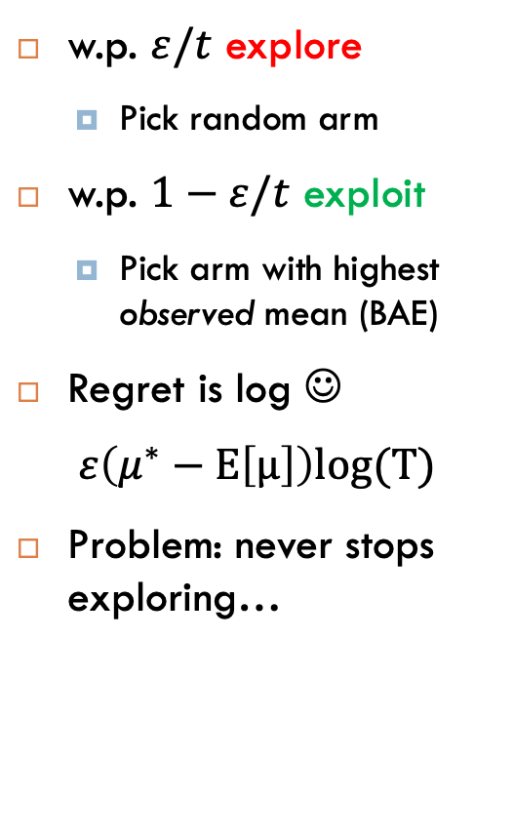
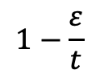
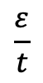
Decaying ε-Greedy
w.p. $ε/t$ explore
Pick random arm
w.p. $1−ε/t$ exploit
Pick arm with highest observed mean (BAE)
Regret is log ☺
$$ε\left(μ^{∗}−Ε\left[μ\right]\right)log(Τ)$$
Problem: never stops exploring…
Arm 1
Explore
1/n
Test arms
$$\frac{ε}{t}$$
1/n
Arm 2
Start of round t
…
1/n
…
Arm n
Basically the same, but prob. of exploring decays every round
$$1−\frac{ε}{t}$$
Exploit
Best arm in expectation (BAE)
Notes:
Write formulas on the board before class

Slide 8
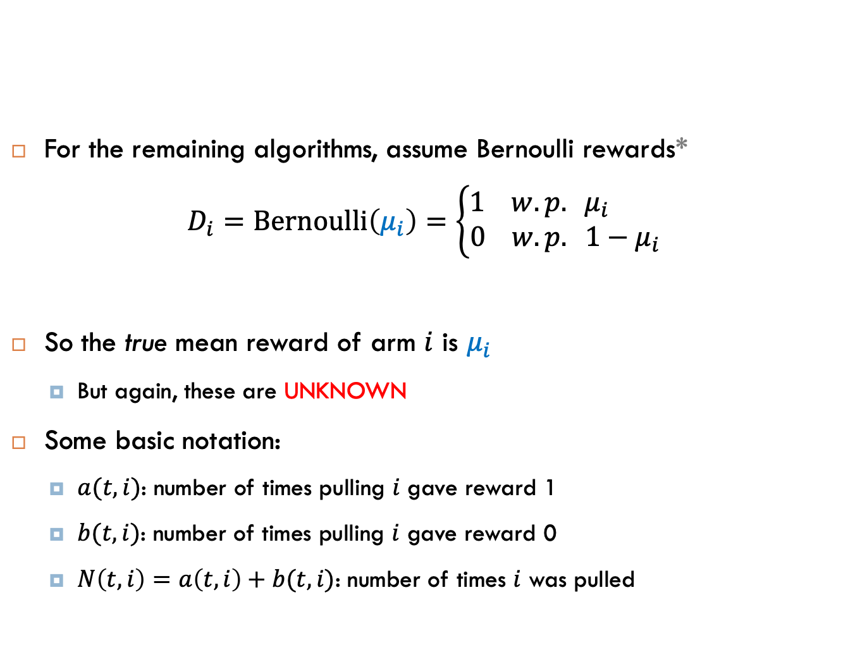
Bernoulli Bandits
For the remaining algorithms, assume Bernoulli rewards*
$$D_{i}=Bernoulli\left(μ_{i}\right)=\left\{\begin{aligned}1 w.p. μ_{i} \\ 0 w.p. {1−μ}_{i}\end{aligned}\right.$$
So the true mean reward of arm $i$ is $μ_{i}$
But again, these are UNKNOWN
Some basic notation:
$a(t,i)$: number of times pulling $i$ gave reward 1
$b(t,i)$: number of times pulling $i$ gave reward 0
$N\left(t,i\right)=a\left(t,i\right)+b(t,i)$: number of times $i$ was pulled
* But this generalizes to other distributions.
Notes:
Write formulas on the board before class

Slide 9
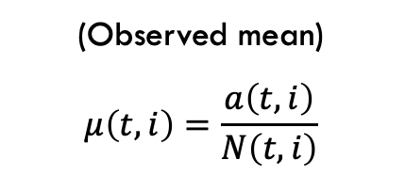
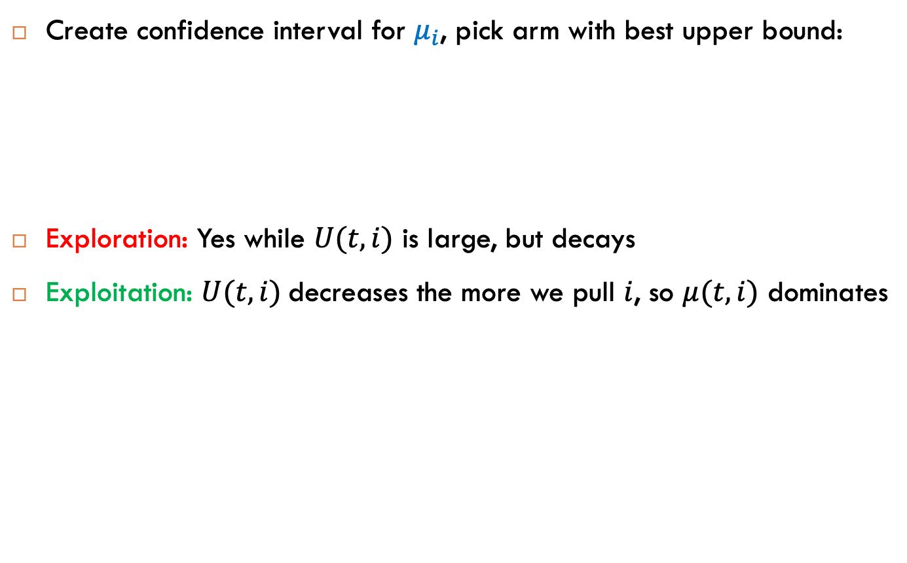
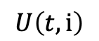
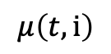
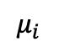
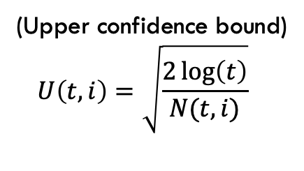
UCB Algorithm
Create confidence interval for $μ_{i}$, pick arm with best upper bound:
Exploration: Yes while $U(t,i)$ is large, but decays
Exploitation: $U(t,i)$decreases the more we pull $i$, so $μ(t,i)$ dominates
(Observed mean)
$$μ\left(t,i\right)=\frac{a\left(t,i\right)}{N\left(t,i\right)}$$
(Upper confidence bound)
$$U\left(t,i\right)=\sqrt{\frac{2\log\left(t\right)}{N(t,i)}}$$
$$μ\left(t,i\right)$$
$$U\left(t,i\right)$$
$$μ_{i}$$
Notes:
Write formulas on the board before class

Slide 10
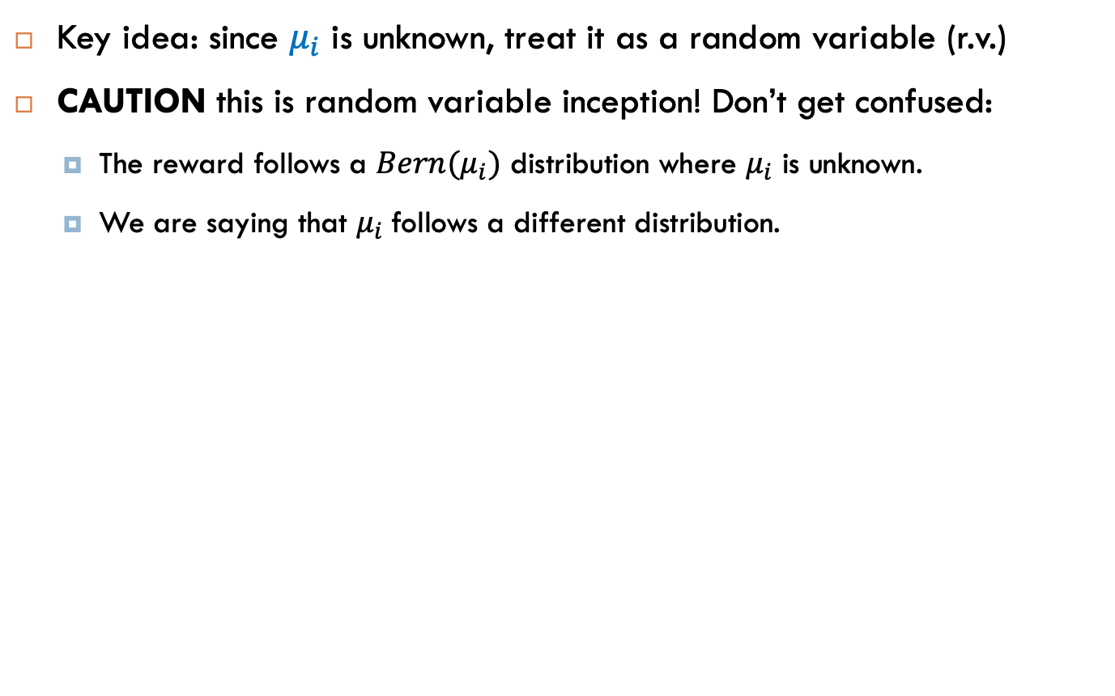
Thompson Sampling
Key idea: since $μ_{i}$ is unknown, treat it as a random variable (r.v.)
CAUTION this is random variable inception! Don’t get confused:
The reward follows a $Bern(μ_{i})$ distribution where $μ_{i}$ is unknown.
We are saying that $μ_{i}$follows a different distribution.
Notes:
Write formulas on the board before class

Slide 11
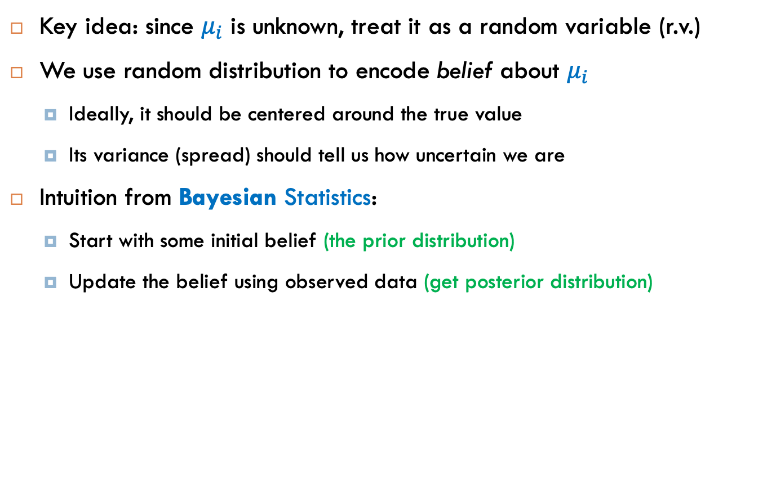
Thompson Sampling
Key idea: since $μ_{i}$ is unknown, treat it as a random variable (r.v.)
We use random distribution to encode belief about $μ_{i}$
Ideally, it should be centered around the true value
Its variance (spread) should tell us how uncertain we are
Intuition from Bayesian Statistics:
Start with some initial belief (the prior distribution)
Update the belief using observed data (get posterior distribution)
Notes:
Write formulas on the board before class

Slide 12
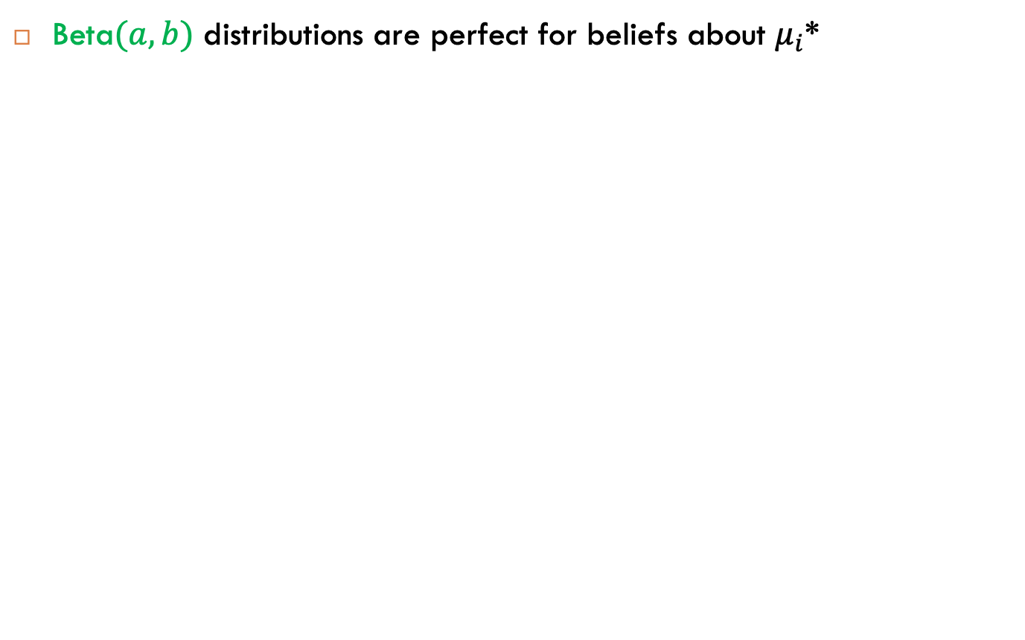
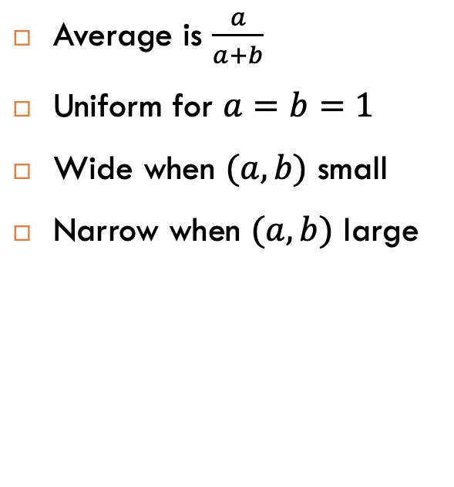
Thompson Sampling with Bernoulli
Beta$(a,b)$ distributions are perfect for beliefs about $μ_{i}$*
Average is $\frac{a}{a+b}$
Uniform for $a=b=1$
Wide when $(a,b)$ small
Narrow when $(a,b)$ large
* And have a theoretical basis.
Notes:
Class of distributions with two parameters a and b
All live in 0-1, which is what we want for a belief about the probability of success of a Bernoulli
For a given a and b, the mean is a / a +b which looks frighteningly like the # success / # success + # failures
And it turns out they get narrower as a/b increase: for (1,1) its uniform (equally likely which is as unimformative as it gets

Slide 13
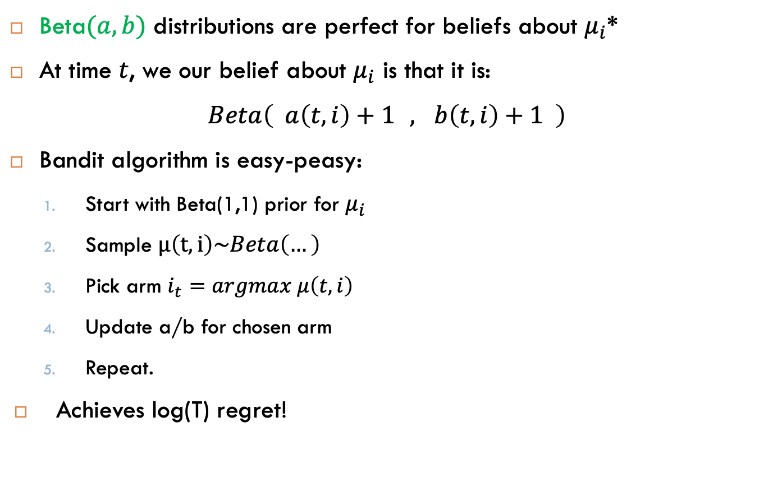
Thompson Sampling with Bernoulli
Beta$(a,b)$ distributions are perfect for beliefs about $μ_{i}$*
At time $t$, we our belief about $μ_{i}$ is that it is:
$$Beta\left( a\left(t,i\right)+1a,ab\left(t,i\right)+1 \right)$$
Bandit algorithm is easy-peasy:
Start with Beta(1,1) prior for $μ_{i}$
Sample $μ\left(t,i\right)\sim Beta\left(…\right)$
Pick arm $i_{t}=argmax μ\left(t,i\right)$
Update a/b for chosen arm
Repeat.
Achieves log(T) regret!
Why take random samples? Naturally does exploration
* And has a theoretical basis.
Notes:
Write formulas on the board before class

